Slide 1
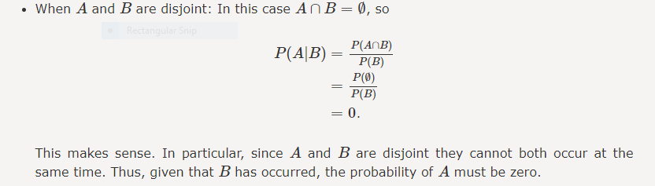
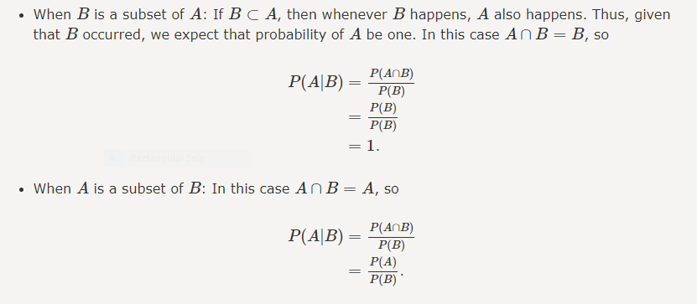

Slide 2
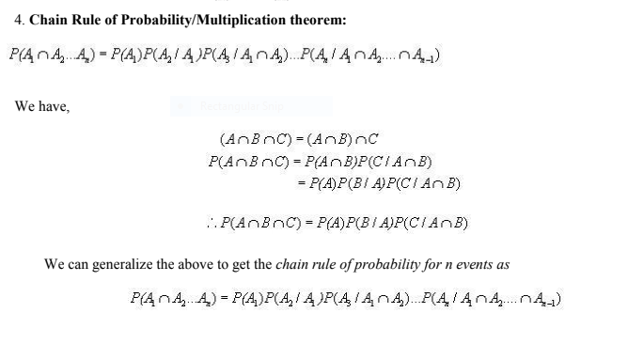

Slide 3
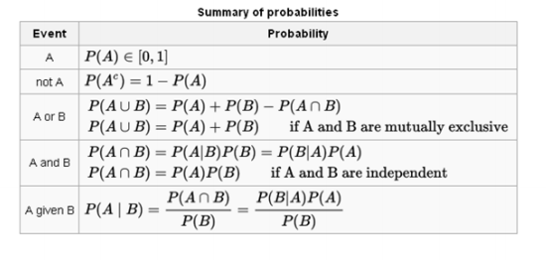

Slide 4
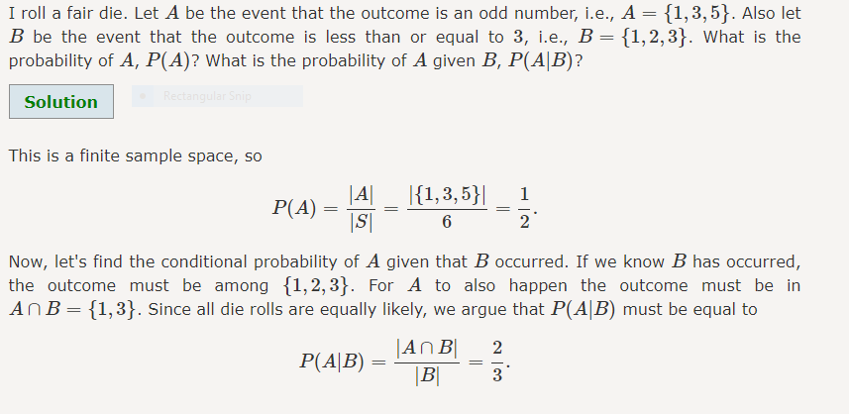

Slide 5
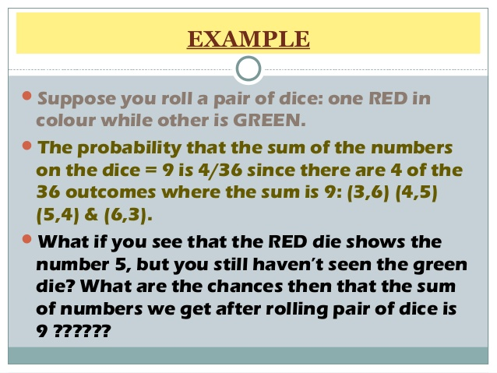

Slide 6
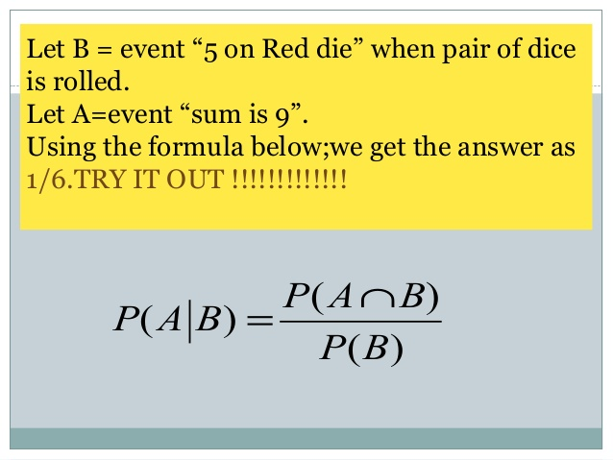

Slide 7
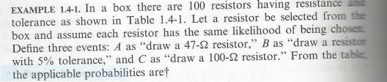
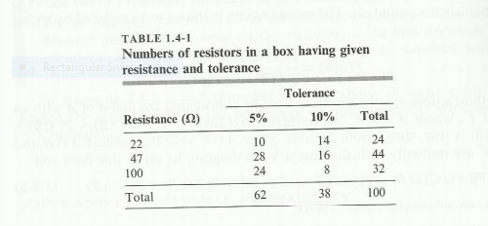

Slide 8
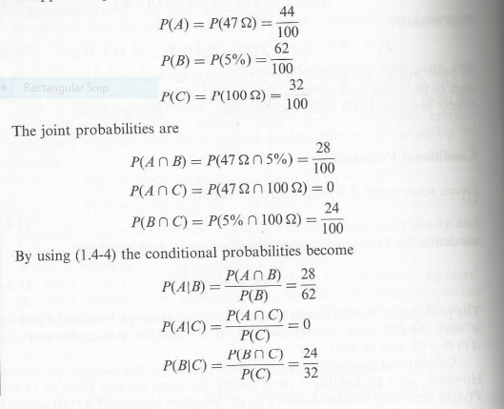

Slide 9
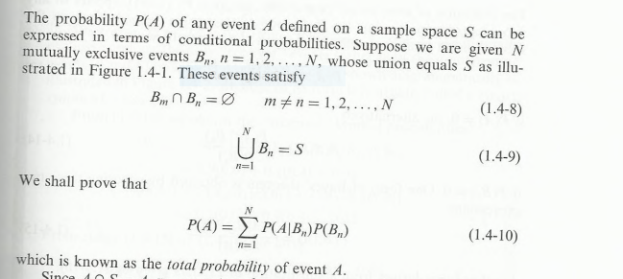
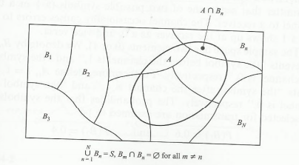
Total Probability

Slide 10
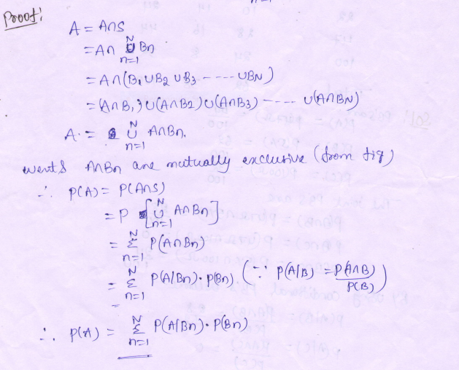

Slide 11
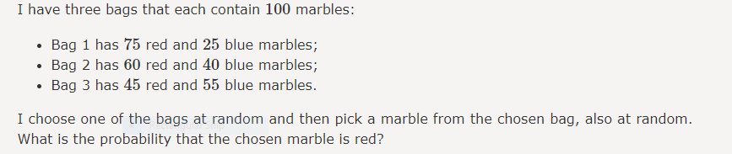
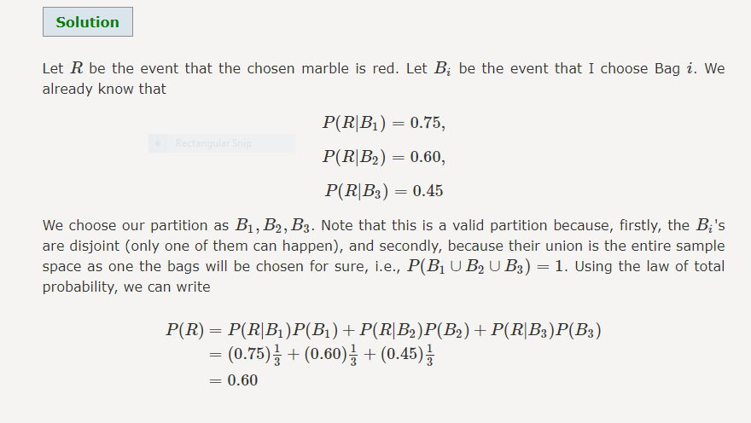

Slide 12
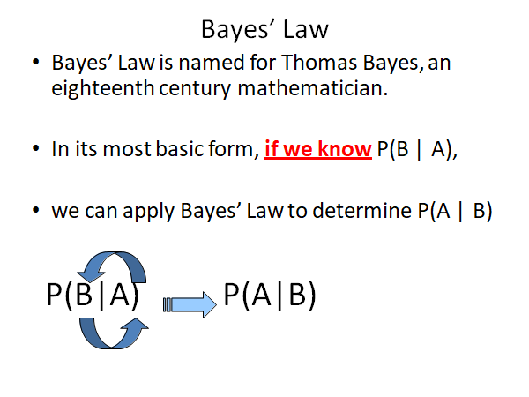

Slide 13
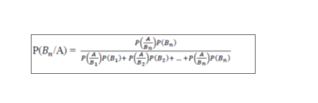
•Baye’s Theorem: It states that if a sample space S has N mutually exclusive events Bn, n=1, 2, 3,…,N. such that Bm∩Bn=ⱷ for m =1, 2, 3, ….,N. and any event A is defined on this sample space then the conditional probability of Bn and A can be Expressed as

Slide 14
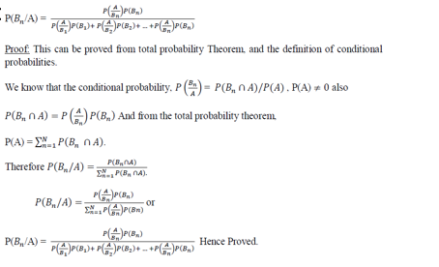

Slide 15
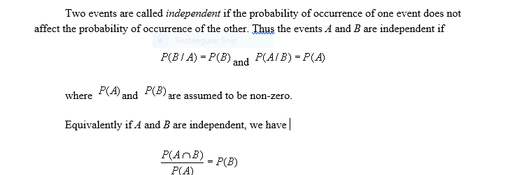
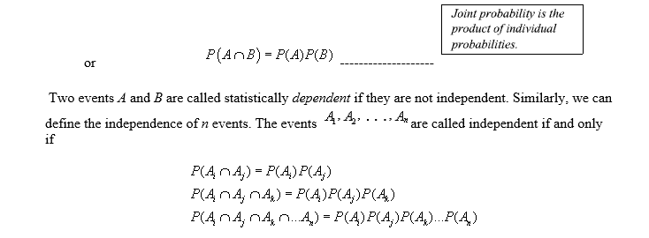
Independent Events

Slide 16
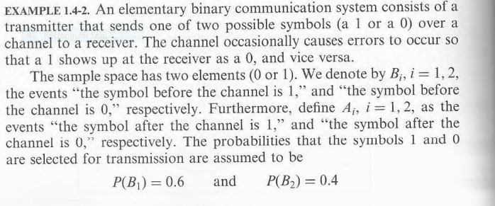
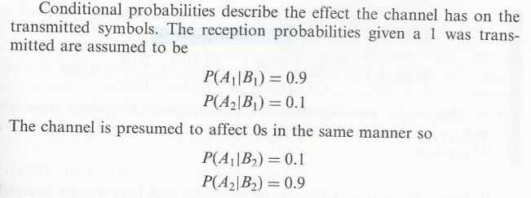

Slide 17
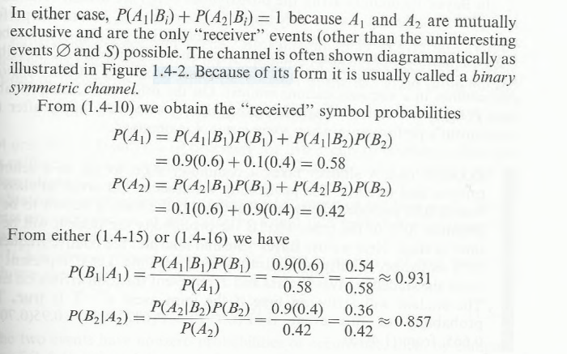

Slide 18
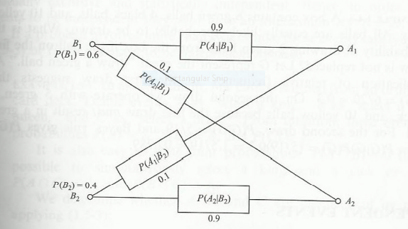
Binary Symmetric communication channel

Slide 19
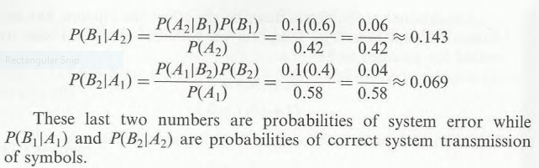
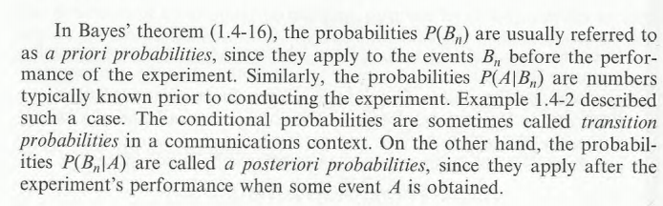

Slide 20
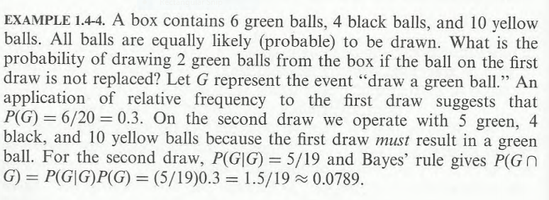

Slide 21
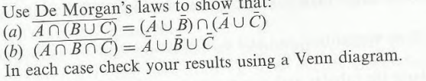
Problems:

Slide 22
(1).A die is tossed. Find the probabilities of the events A={odd number shows up}, B={number larger than 3 shows up}, A U B and A ∩ B.
S={1,2,3,4,5,6}
A={odd no shows up}
A={1,3,5}
B={number larger than 3 shows up}
B={4,5,6}
P(A)=no of possible out comes/total no.6 of outcomes (or)p(s)=1
P(A)=3/6=1/2 each outcome has probability of 1/6
ie)P(1)=P(2)=P(3)=P(4)=P(5)=P(6)=1/6
P(A)=P(1)+P(3)+P(5)=1/6+1/6+1/6=3/6=1/2
P(B)=P(4)+P(5)+p(6)=1/6+1/6+1/6=3/6=1/2
A U B={1,3,4,5,6}
P(A U B )=p(1)+P(3)+P(4)+p(5)+p(6)=1/6+1/6+1/6+1/6+1/6=5/6
A ∩ B={5}
P(A ∩ B)=p(5)=1/6

Slide 23
(2). In a game of dice, a ‘shooter’ can win outright if the sum of the two numbers showing up is either 7 or 11 when two dice are thrown. What is his probability of winning outright?
A={sum is 7}
B={sum is 11}
There are 36 possible outcomes
Each outcome with a probability of 1/36
A={(1,6),(2,5),(3,4).(4,3),(5,2),(6,1)}
P(A)=6*1/36=1/6
B={(5,6),(6,5)}
P(B)=2*1/36
A or B=(AUB)={(1,6),(2,5),(3,4).(4,3),(5,2),(6,1),(5,6),(6,5)}
P(AUB)=8/36

Slide 24
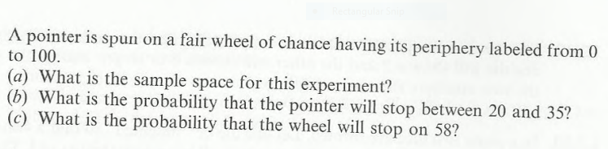
(3)

Slide 25
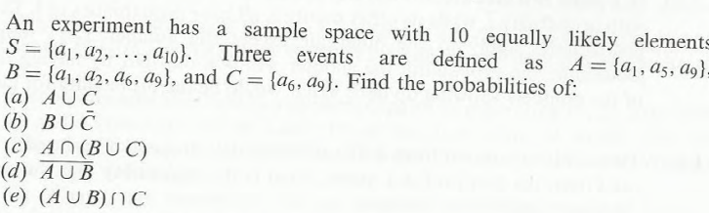
4.

Slide 26
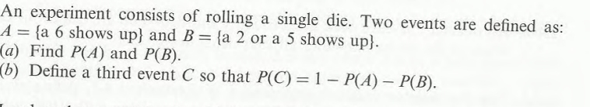

Slide 27
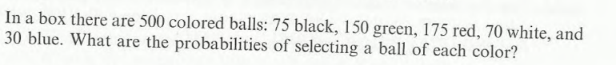

Slide 28
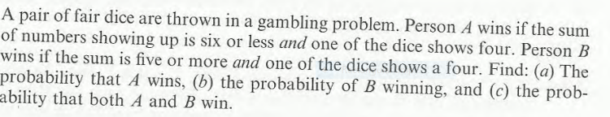

Slide 29
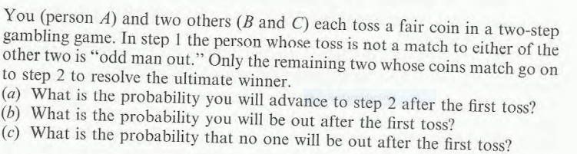

Slide 30
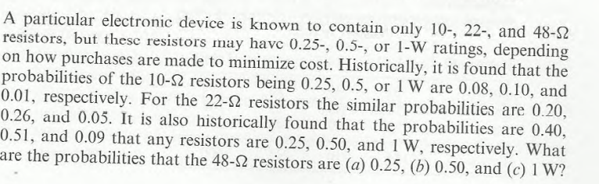

Slide 31
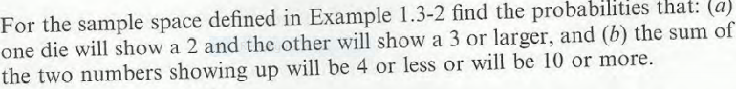

Slide 32
If A is subset of B then show that P(A)≤ P(B)

Slide 33
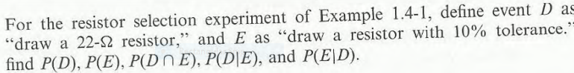

Slide 34
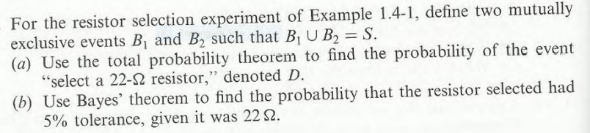

Slide 36
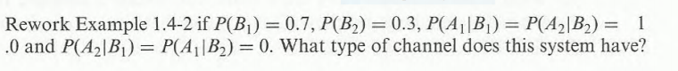

Slide 37
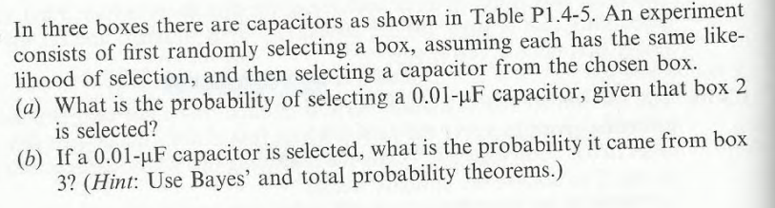
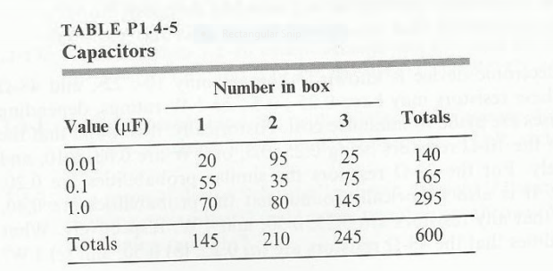

Slide 40
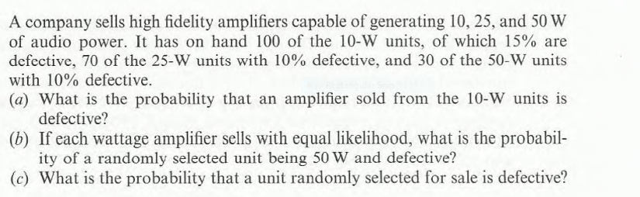

Slide 43
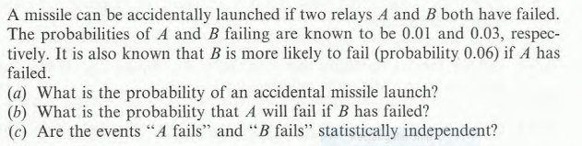

Slide 45
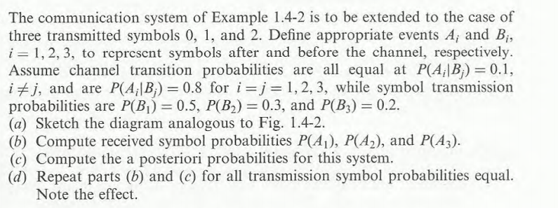

Slide 48
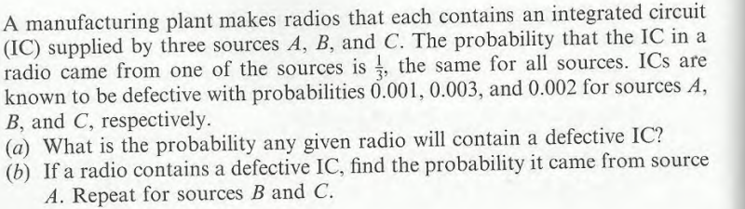

Slide 50
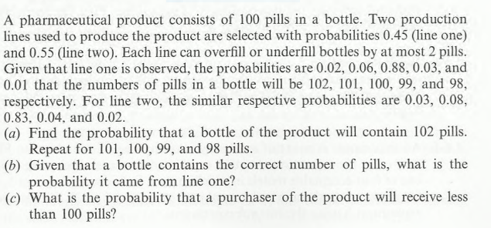

Slide 53
A, B, C are three mutually exclusive and exhaustive events associated with a random experiment. Find P(A), it being given that P(B)=3/2​P(A) and P(C)=1/2​P(B).
Ans: Let P(A)=p. Then, P(B)=3/2​P(A)⟹P(B)=3/2​p and P(C)=1/2​P(B)⟹P(C)=3/4​p
Since A, B, C are exhaustive events associated with a random experiment.
A∪B∪C=S
P(A∪B∪C)=P(S)
P(A∪B∪C)=1 (from axiom 2 P(S)=1)
P(A)+P(B)+P(C )+P(A ∩ B) +P(B ∩ C)+P(C ∩ D)+P(A ∩ B ∩ C) =1
P(A)+P(B)+P(C)=1 (Because P(A ∩ B) =P(B ∩ C)=P(C ∩ D)=P(A ∩ B ∩ C)=0 as A, B, C are three mutually exclusive events )
p+3/2​p+3/4​p=1
p=4/13​
P(A)=4/13​

Slide 55
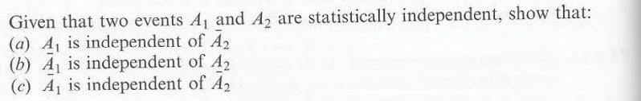

Slide 58
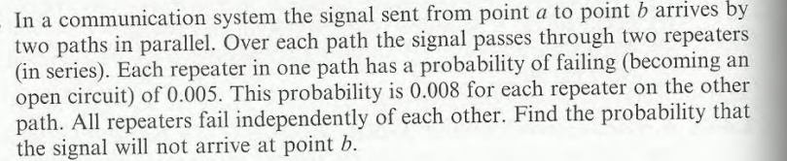

Slide 60
